Slide 1
Study and implement van Emde Boas tree with application to Prims and compare wrt Union Find and RB Tree
Gajanan Modi(2019201049)
Jeevesh Kataria(2019201058)

Slide 2
Van Emde Baos Tree
It Implements Opertaion in O(log m) time or O(loglogm) time where m=2^n elements stored in tree.

Slide 3
Prims Algorithm
It finds Minimum Spanning Tree for a Weighted Undirected Graph .
When Implemented With Binary Heap, Complexity is O(ElogV +VlogV)
VlogV-> log V is Extract Min operation and we are using it V times.
ElogV-> Updating the edge in the tree by using adjacency list.

Slide 4
Target:
1.Try to Implement Prims Algorithm by Van Emde Boas Tree ,
RB Tree and Union Find Data Structure.
2.Compare Complexity with Different Data Structure used.

Slide 5
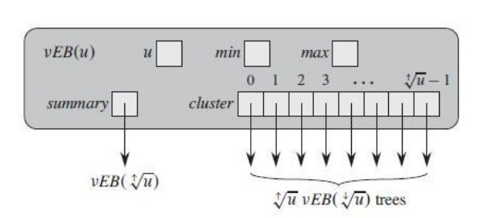
Van Emde Boas
VEB

Slide 6
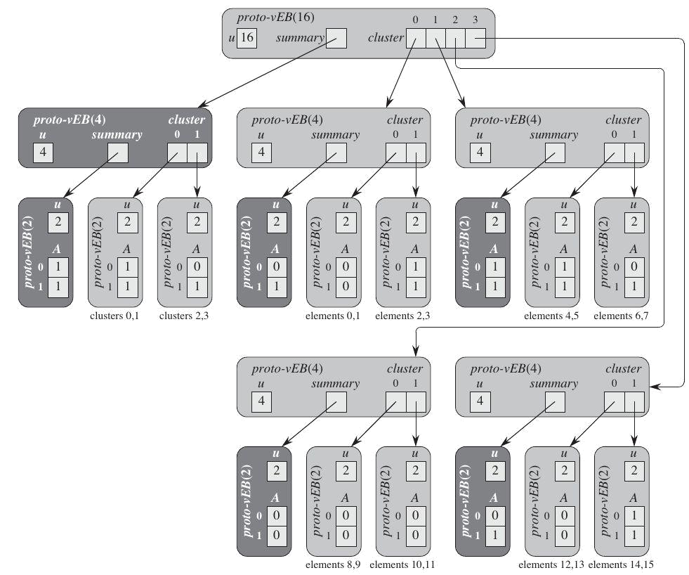

Slide 7
Red Black Tree
Red-black trees are a variation of binary search trees to ensure that the tree is balanced.
Height is O(lg n), where n is the number of nodes
Operations take O(lg n) time in the worst case.

Slide 8
Red Black Operations we have used
Extract-Min
Insertion
Deletion

Slide 9
AVL Tree

Slide 10
So far …
  Binary search trees store linearly ordered data
  Best case height: Θ(ln(n))
  Worst case height: O(n)
Requirement:
  Define and maintain a balance to ensure Θ(ln(n)) height

Slide 11
Drawback
More Time Required for Rotations in case of
Successive insertions and deletions.

Slide 12
PRIM’S ALGORITHM
Prim’s algorithm is a greedy algorithm that finds a minimum spanning tree for a weighted
undirected graph. This means it finds a subset of the edges that forms a tree that includes
every vertex, where the total weight of all the edges in the tree is minimized.
The algorithm operates by building this tree one vertex at a time, from an arbitrary starting
vertex, at each step adding the cheapest possible connection from the tree to another vertex.

Slide 13
RESULT
Comparision Between VEB,RB,AVL
Tested on:O(10^4) input
Time:AVL>RB>VEB
VEB took less time because of required operations complexity.

Slide 14
Thankyou.

